Slide 1

Online Certificate Validation Using Blockchain
Group No. 8
Rutwik Gaikwad
Prasad Jadhav
Aseem Godambe

Slide 2
Contents
Abstract
Introduction
Objectives
Literature Review
Problem Definition
Existing System Architecture/Working
Proposed System Architecture/Working
Conclusion
References
Publication

Slide 3
Abstract
There are many issues that we face everyday in our college. This project aims to solve as many issues faced by the college as possible.
Our college conducts extra curricular courses for the benefits of the students. Students are provided with certificates at the end of the course on successful completion.
Currently the certificates are just printed copies that do not have any proof of validation and there are chances of forgery. Our proposed system uses BlockChain system to create and validate certificates from a central system.

Slide 4
Introduction
In today’s world, there is a huge competition for jobs. The companies need skilled labor for their jobs. Certification is a great way to prove your expertise in any subject. Official Certificates with a proper verification system gives an added advantage to the certificate. Our system proposes to build a system for creation and authentication of these certificates.

Slide 5
Objectives
To make a secure and simplified system for Distribution and Verification of Certificates.

Slide 6
Literature Review - 1
Paper Title: Online Certificate Validation Using Blockchain
Authors: Shanmuga Priya R, Swetha N
Publication Details: Int. Jnl. Of Advanced Networking & Applications (IJANA)
Findings: Lakhs of people getting Degrees year after year, due to the lack of effective anti-forge mechanism, events that cause the graduation certificate to be forged often get noticed. In order to solve the problem of counterfeiting certificates, the digital certificate system based on blockchain technology. All the illegal activities filed against a person and all the activities are updated in the Personal ID. Using the modification process we would monitor not only the degree cortication alone but also entire personality and behavioral activities of that person. We deploy Unique based monitoring using this system.
Advantages: User friendly, easily accessible, reliable, simple user interface
Disadvantages: QR Codes are difficult to manage, difficult to send bulk QR codes.

Slide 7
Literature Review - 2
Paper Title: Certificate Verification System using Blockchain
Authors: Nitin Kumavat, Swapnil Mengade, Dishant Desai, JesalVarolia
Publication Details: International Journal for Research in Applied Science & Engineering Technology (IJRASET)
Findings: During the course of education the students achieve many certificates. Student produce these certificates while applying for jobs at public or private sectors, where all these certificates are needed to be verified manually. There can be incidents where students may produce the fake certificate and it is difficult to identify them. This problem of fake academic certificates has been a longstanding issue in the academic community. Because it is possible to create such certificates at low cost and the process to verify them is very complex, as they are manually needed to be verified. This problem can be solved by storing the digital certificates on the Blockchain. The Blockchain technology provides immutability and publicly verifiable transactions, these properties of Blockchain can be used to generate the digital certificate which are anti-counterfeit and easy to verify.
Advantages: User friendly, flexibility.
Disadvantages: Complexity for developing, Browser only.

Slide 8
Problem Definition
The main challenge faced by our college is that the certificates provided for Value-Added Courses are not full proof and there is no scope of verification.
Another problem faced by students is to search content on Moodle Course Page.
Contacting college faculties without any contact details is also a major problem.
Maintaining and Analysing records of Final Year Projects is also a difficult task.

Slide 9
Existing System Architecture/Working
Currently the certificates for Value-Added Courses are given in hard copy and the only way to verify them is by contacting the college on their official mail.
There is no system to crawl the Moodle content and students have go through a lot of redirects to find the correct page.
Students have to find contact details by contacting their HOD’s in order to contact faculties of other department or have to ask a lot of people to get in touch of Faculties or Council.
Hand-written records are maintained for managing Project Log Books of Final year projects.

Slide 10
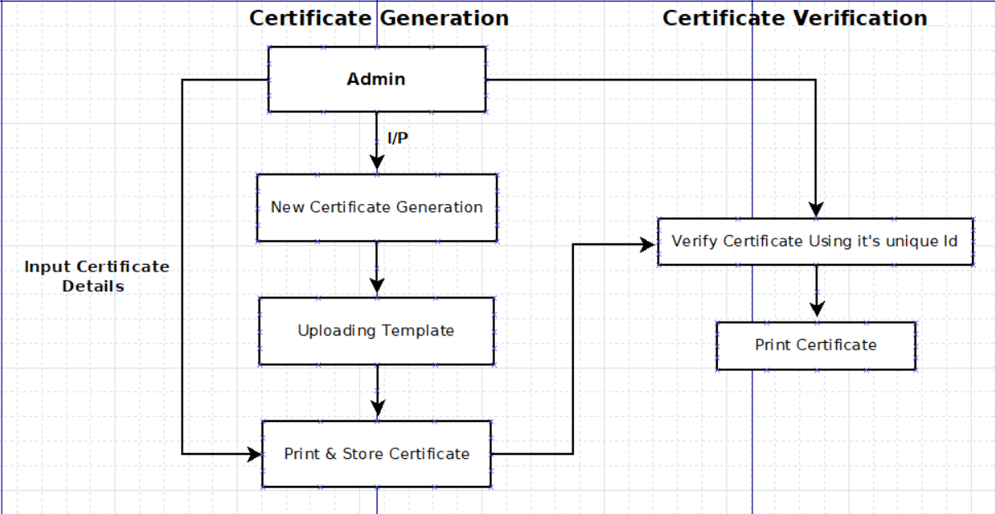
Proposed System Architecture/Working
Module 1: Certificate Generation and Verification

Slide 11
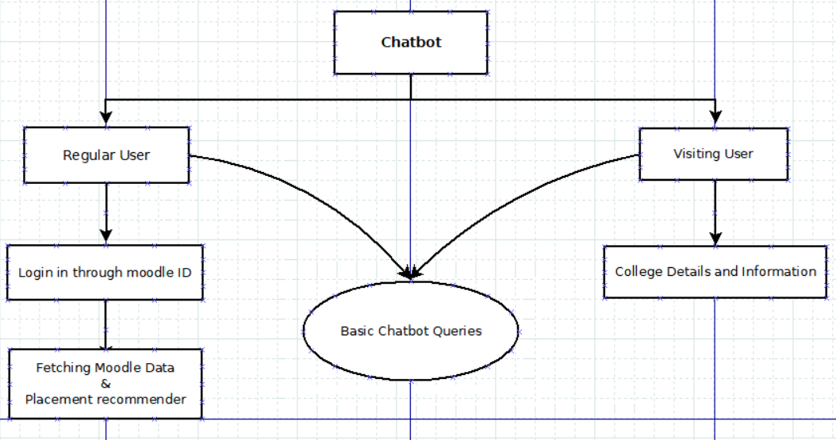
Module 2: ChatBot

Slide 12
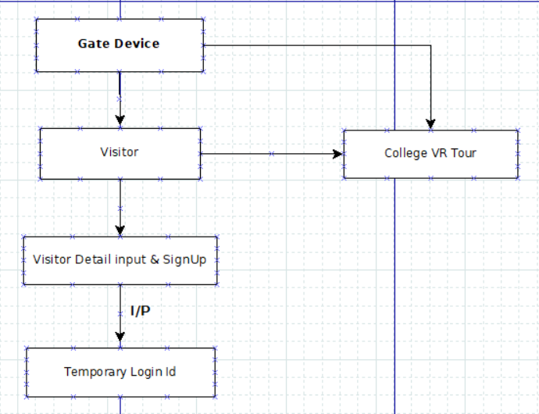
Module 3: Gate Device

Slide 13

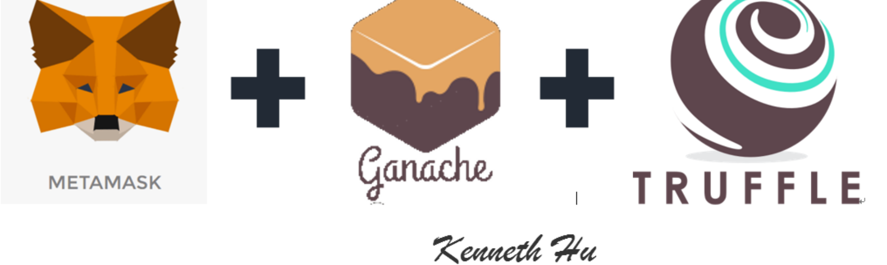

Technology Stack
Front End
Middle-tier
Backend

Slide 14
References
https://www.ijana.in/papers/37.pdf
http://ijraset.com/fileserve.php?FID=20914
https://www.blockcerts.org/
https://www.blockchain-council.org/blockchain/document-verification-system-using-blockchain/

Slide 15
Conclusion
With the proposed idea we can conclude that this application would be able to:
Generate and Validate certificates hence, reducing possibility of forgery.
Solve maximum possible queries through a smart Chatbot.
Locate teachers within the campus.
Maintain a Project log book hence keeping a track of progress of Final Year projects with timely updation.
With this we can say that the proposed application will solve majority of the problems that many colleges face and would be very efficient to save time and human effort.

Slide 16
Thank You...!!

